Slide 1
Market Survey Findings
“INCREASING TRADE WITH THE EUROPEAN UNION”
Hilton Trinidad & Conference Centre Wednesday 23rd November, 2016

Slide 2
SELECTING MARKETS

Slide 3
Selection Criteria
Quantitative Criteria | Qualitative Criteria
Value of Global Imports from product list | Familiarity with culture
Growth in Global Imports from product list | Diaspora presence
Value of Imports from Trinidad and Tobago | In-Market Support
# Trading partners | Prior Work in Market
GDP Growth | Opportunities for Services Exports
Inflation
Unemployment
Debt

Slide 4
Markets Selected
Selection Criteria
Exporter Interest
France Netherlands
UK
Feedback from Consultants

Slide 5
SELECTING COMPANIES

Slide 6
Selection Criteria
Success in Domestic Market
Internationally Competitive Products
Willingness and Ability to Adapt Products
Production Capacity
Staff Experience
Financial Soundness

Slide 7
Project Scope
Approximately 30% of the Participating Tier 2 and Tier 3 enterprises are women-owned/led
Approximately 30% are rural-based MSMEs (YTEPP, Export Centres and Tobago)
Representation of Goods and Services Companies
Mixture of companies which export ready and those which require capacity building

Slide 8
Companies Selected
Selection Criteria
Project Scope
In-market Research
16 Export Ready Companies (8G and 8S)
10 Capacity Building (5G and 5S)

Slide 9
Objectives of the Mission
Attain information which can assist participants’ in achieving their objectives for the project.
Explore the possibility of co-creation as an alternative to ‘traditional’ market entry.

Slide 10
Major Highlights
Market Research Training
14 export dashboards completed
Review of Market Information from Trade Map, Euromonitor, CBI Netherlands and EU Helpdesk.
Market Survey to France (Lyon and Lille), Netherlands (Rotterdam and Amsterdam) and United Kingdom (London)
Key contacts gathered

Slide 11
Clusters
The region of Rhone-Alpes is the second richest in France and 8th richest in Europe. All of its industries are arranged into clusters.
30 clusters comprising of companies, universities, laboratories and institutions, all geared towards developing and enhancing innovative projects which boost employment and competitiveness.
Driving and supporting these market oriented clusters are research oriented competitiveness poles.

Slide 12
Networks
Negative connotations → Strategy of mutual benefit
The important principle guiding these networks is credibility

Slide 13
GOODS SURVEY FINDINGS

Slide 14
UNITED KINGDOM
The United Kingdom is the biggest market for Caribbean Foods and seems to be a natural starting point for food companies trying to enter Europe
Caribbean products are grouped with African products to create an African-Caribbean category.
Grace Kennedy is the major importer of Caribbean products. Other players include Wanis, Dees Imports, East End and KTC.
The market is not just London. Birmingham, Manchester, Wales, Ireland and Scotland.

Slide 15
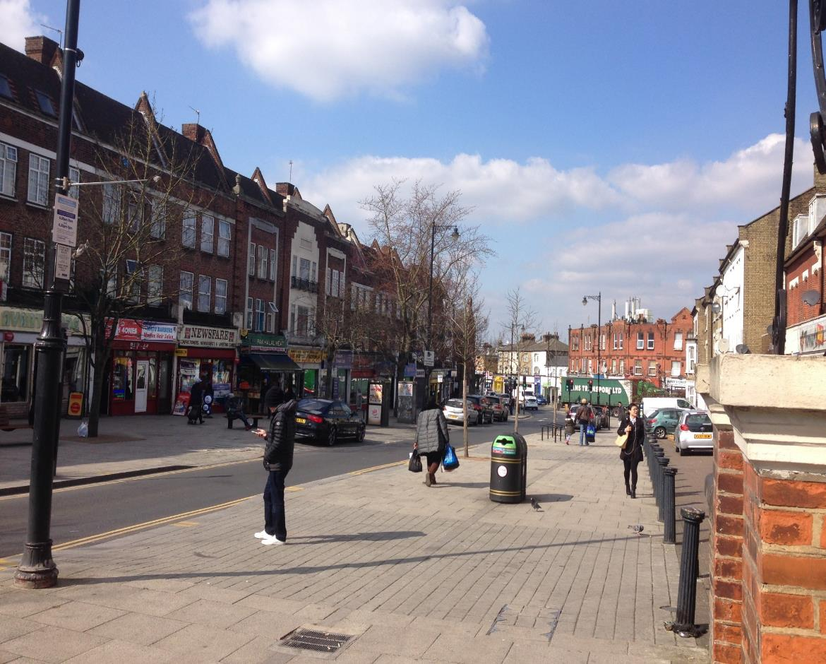
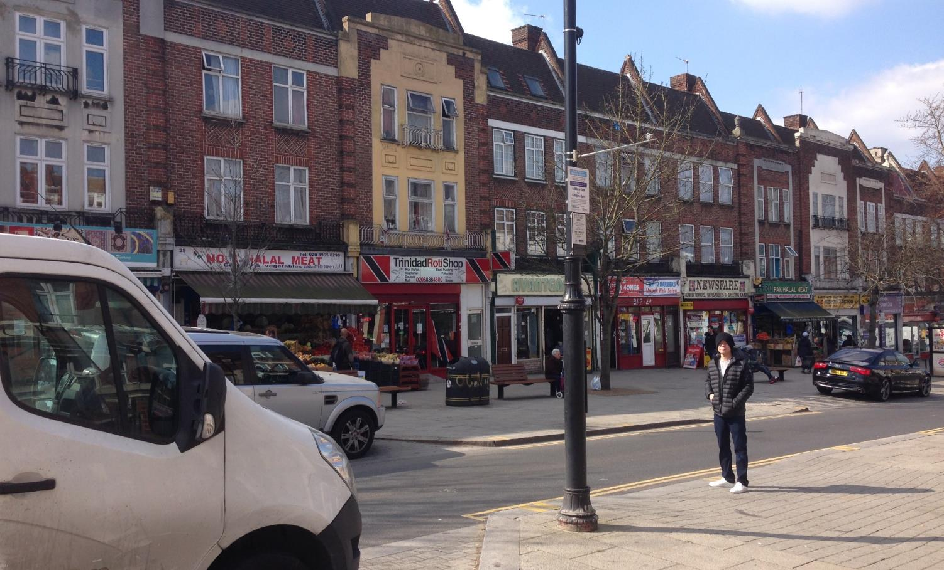

Slide 16
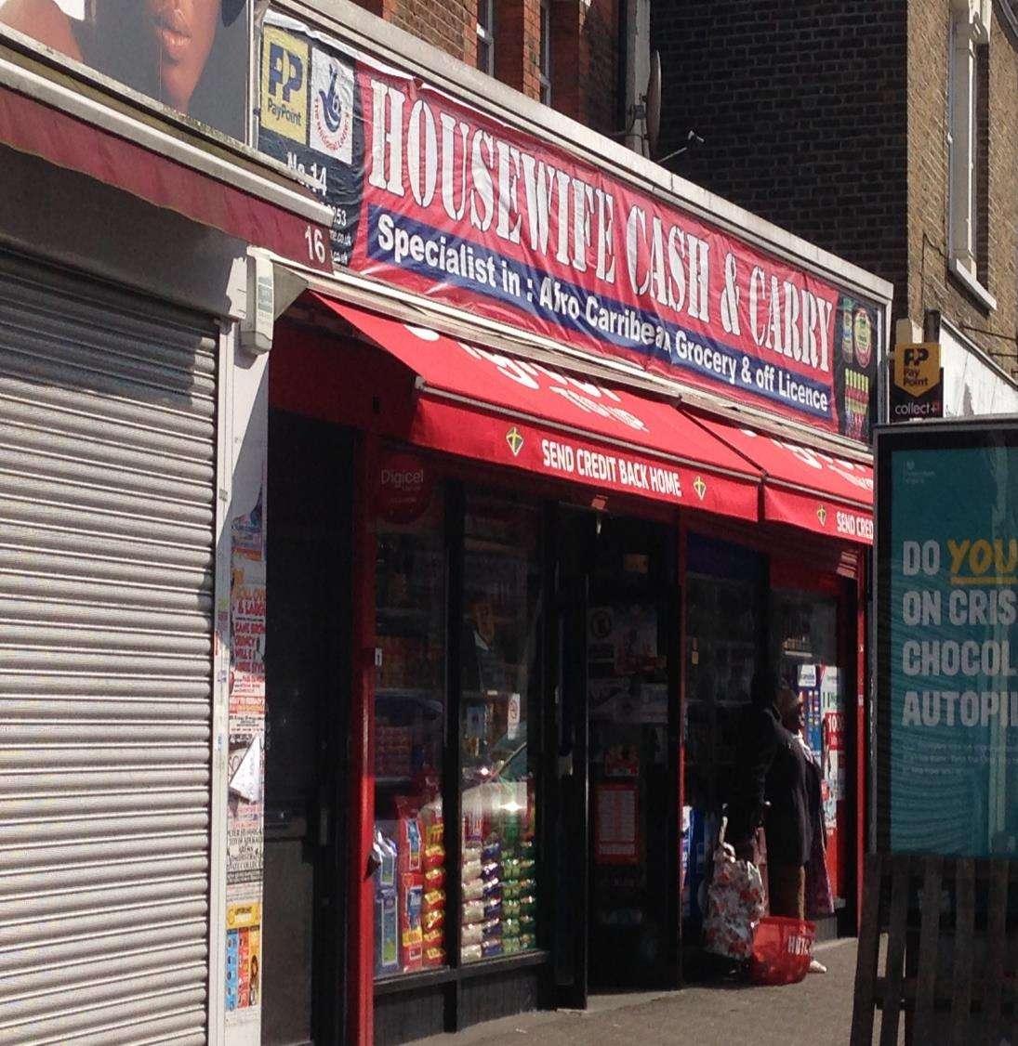
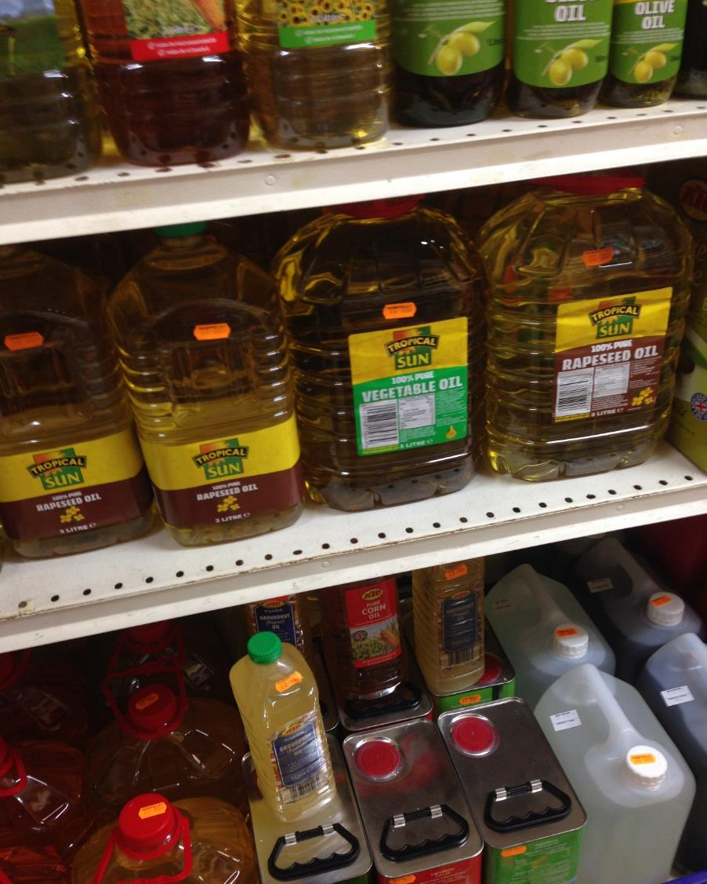

Slide 17
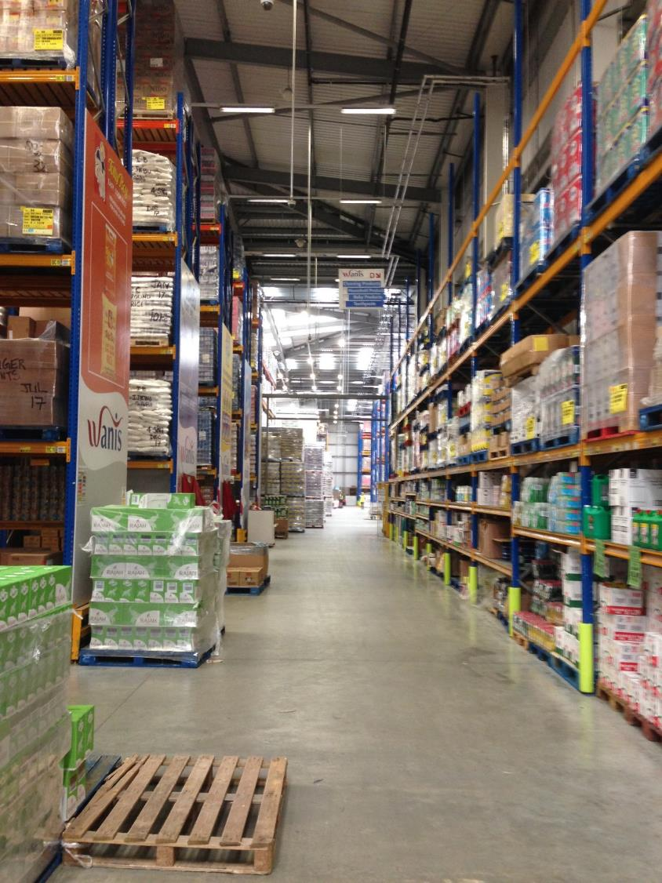
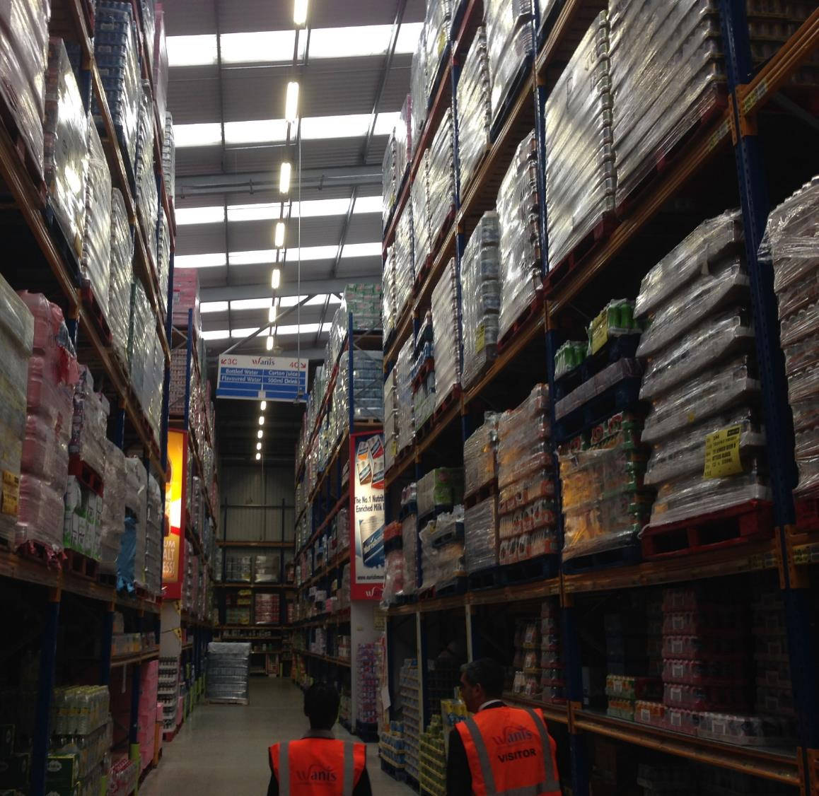

Slide 18
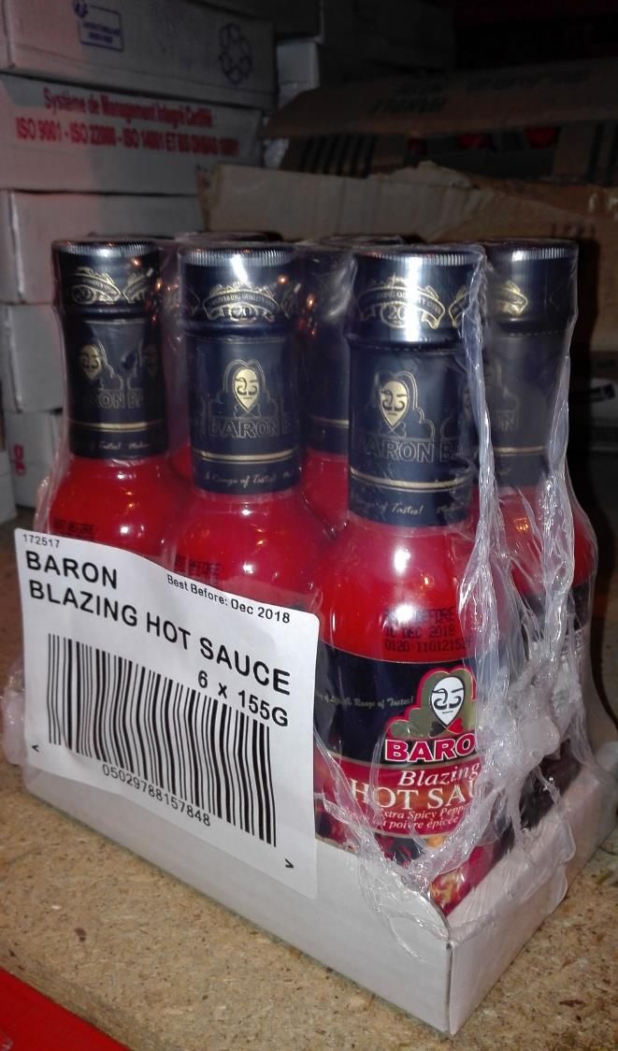
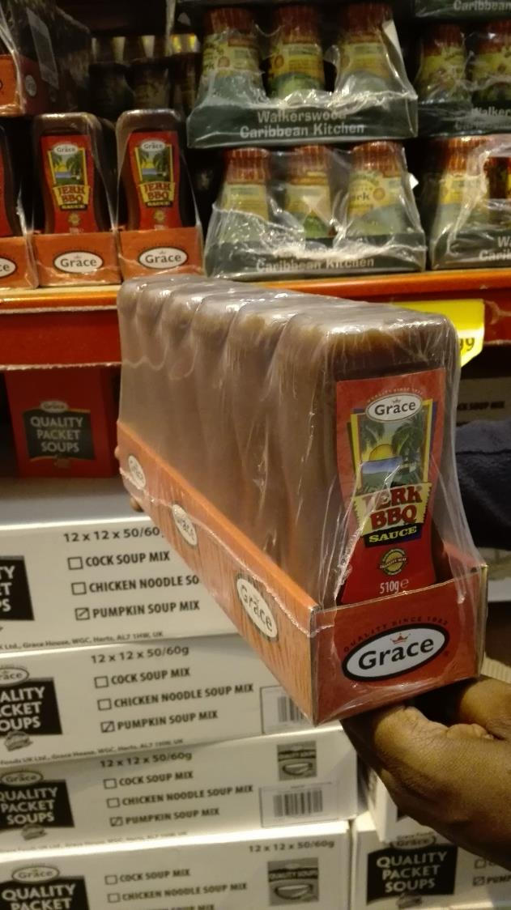

Slide 19
Alternative Channel

Slide 20
NETHERLANDS
There is a growing trend towards global foods as more people from the Netherlands are travelling and being exposed to new foods.
There has also been an influx of immigrants
Diaspora demand has been falling as the generations increase.
Increasing demand for ready to eat meals.
Consumers demanding products differently – Smaller bottle sizes, more variety, convenience etc.
Customers do not see origin countries just ‘Caribbean’

Slide 21
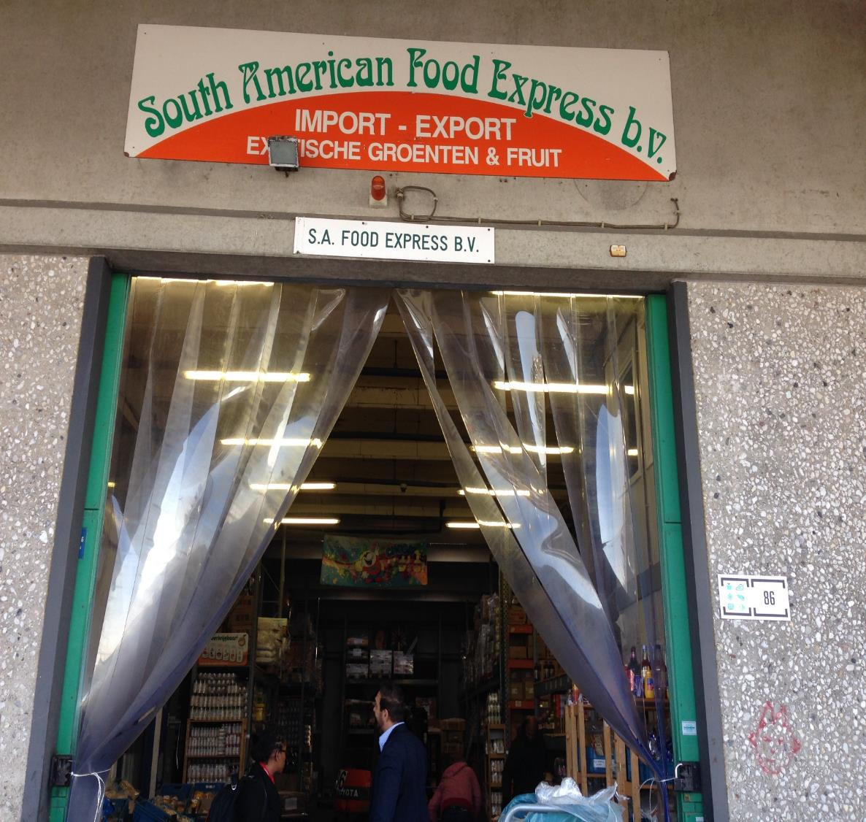
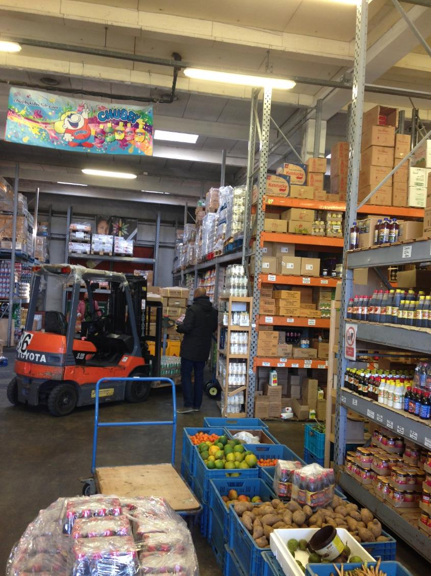

Slide 22
SAFE’S ENTRY STRATEGY
Specific supermarkets within the Caribbean areas were targeted to build up a substantial client base.
This helped to make the products known in the market.
When the company reached about 60 clients it became easier to negotiate with the supermarket chains.
What happened is the supermarket chains took note of the products and contacted SAFE rather than the other way around.

Slide 23
Challenges
Caribbean products are growing in popularity and are more noticed by regulatory authorities. (ISO and HACCP)
The is growing competition from other Caribbean Exporters particularly Jamaica.
Replication of Caribbean products eg. Reggae Reggae Sauce and Tropical Sun
Diaspora demand is falling due to increase generations (2nd and 3rd)
Packaging – Barcodes, Shelf Ready, Attention Grabbing, Smaller Sizes.
Exporters sometimes focus on selling and not on building brands.

Slide 24
Recommendations
If operating in the Caribbean channels products need to be Caribbean and not look US/European.
Better distributor relationships which involve brand building, clear KPIs and customer feedback.
Standards, Packaging and labelling, USPs, Product sizes should be included in exporters’ plans and budgets as they become increasingly relevant.
UK and Netherlands are the top destinations for Caribbean products due to geographic concentration of consumers. France does not yet seem to have the critical mass.

Slide 25
SERVICES SURVEY FINDINGS

Slide 26
France - Fashion
Many of the new designers are being launched from Incubators and Accelerators
The up and coming designers face the same problems which our designers face like adequately dealing with the business side.
Huge possibilities for co-creation and partnerships between local and French designers
The formula for creating new designers seem to be a good one based on a national average of 50% conversion of ideas to businesses in incubators.

Slide 27
Case Study Village des Createurs, Rhone Alpes
Non-Profit with many major industry players on their Board of Directors
Platform for designers to develop and commercialise lines – idea to business conversion rate above national average 65% (national average 50%)
Provides work and retail space for three (3) years and vigorously monitors their production and progress.
Annual evaluations on progress.

Slide 28
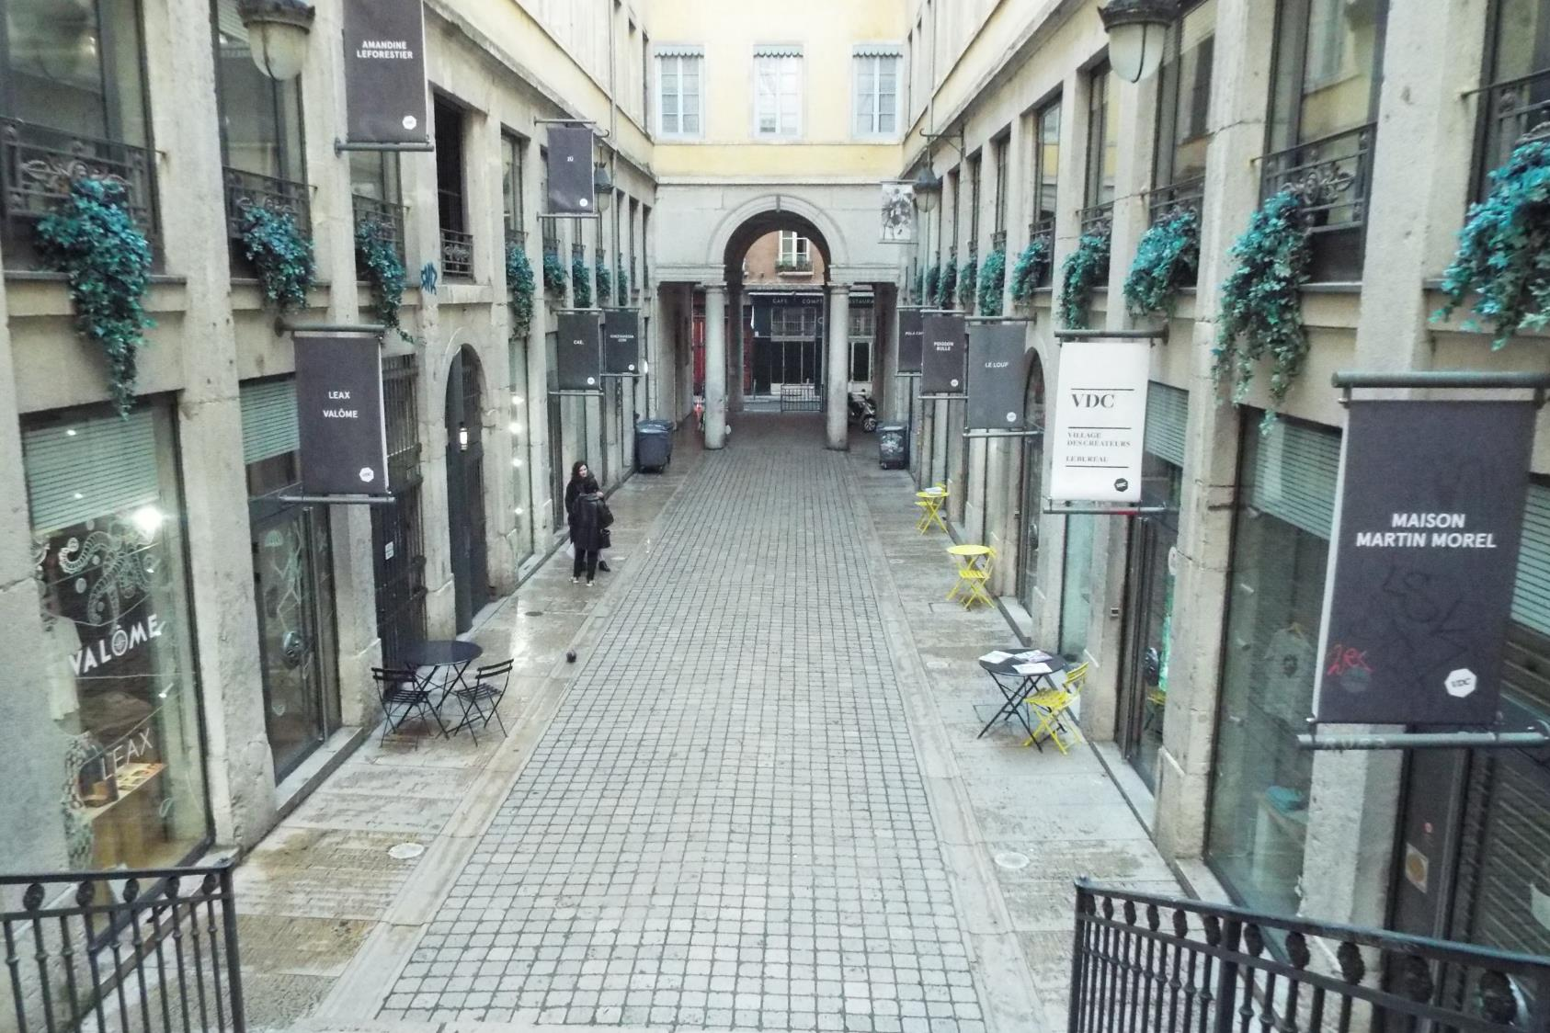

Slide 30
Netherlands - Fashion
Cities of Amsterdam and Rotterdam branding itself as young, vibrant and design-oriented cities;
Dutch people like the story. How was the product made? Who you are and why you are in business?
High Social Media Usage particularly Instagram among small designers for marketing of new designs and generation of sales.

Slide 31
Case Study Pole de Pixel - France
Pole de Pixel established in 2009
Home to 110 companies and 660 employees in the Amination value chain with a physical office and production space
Home to Imaginove, a Animation cluster that connected all players within the value chain to one another for training, development and project execution
Companies supply services to large companies like UBISOFT
Competitions which encourage companies to team up to bid on projects.

Slide 32
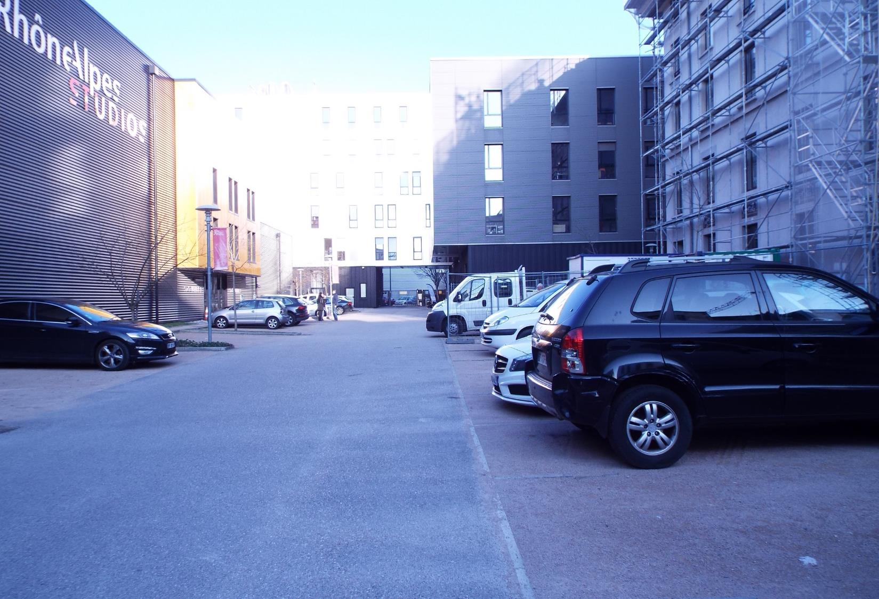

Slide 33
Challenges
High level of differentiation required for market entry
The quality for products are high and should be consistent across all units.
Getting your products into boutiques may be quite difficult.
Language can be a huge barrier particularly in the animation industry where creative thoughts have to be explained.
Sometimes creativity has to be sacrificed in favour of smaller ‘routine’ jobs in a project.

Slide 34
Recommendations
Ensure that the quality and production is worked out prior to participation in Fashion Shows.
Greater use of well developed websites with ecommerce facilities and social media to push companies and products.
Review the websites for the incubators highlighted to get insights into designs and prices.
Explore some of the networks and contacts in the market to see what is possible.

