Slide 1


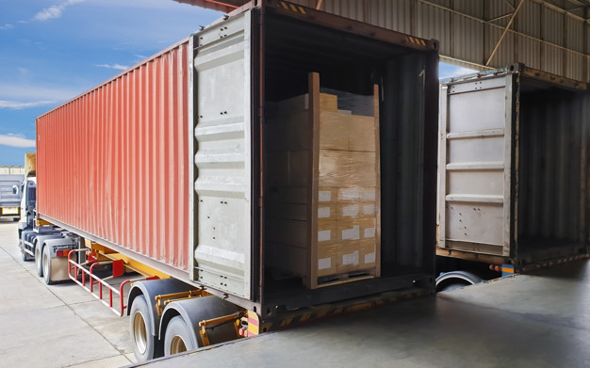
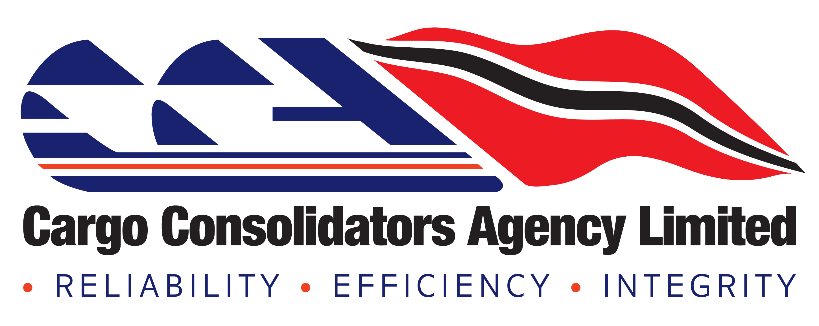
Doing Business in Dominican Republic
Presenter: Stacy Baig

Slide 2
CARICOM-DOMINICAN REPUBLIC FREE TRADE AGREEMENT
The CARICOM – Dominican Republic Free Trade Agreement was signed on August 22, 1998. It grants Trinidad and Tobago’s exporters access to more than eight million consumers in the Dominican Republic market.
This agreement eliminates border taxes on all goods imported from and exported to the Dominican Republic other than those specifically listed or deemed economically sensitive.

Slide 3
DOING BUSINESS IN DR:
Trinidad and Tobago has been a net exporter to the Dominican Republic over the period 2016-2020.
In 2020, Trinidad and Tobago exported products valued at approximately TT$ 302 million and imported approximately TT$ 254 million from that market.
The main products exported in 2020 were urea, prepared foods, plastic bottles, glass bottles, copper conductors, toilet paper and natural gas, while the top imported products were bananas, mineral water, tobacco, plastic packaging, gypsum, condiments, circuit breakers and avocados.
Notes:
Source : https://tradeind.gov.tt/tt-dominican-republic-ready-to-strengthen-trade-relations/

Slide 4
DOING BUSINESS IN DR:
Export requirements include the following:
Mandatory documents required:
Shipping document (BL or AWB)
Commercial invoice(s)
Origin Certificate
Packing list(s)
Cargo description to complete Classification Number / HS code
Additional documents (where applicable) *
Copy of the Bill of Lading
Licenses
Non-Tariff Regulations Certificates
Origin Certificate

Slide 5
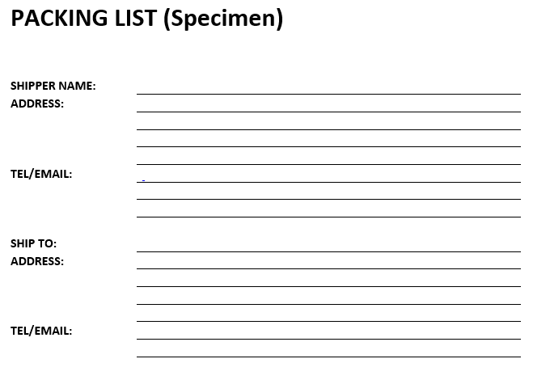
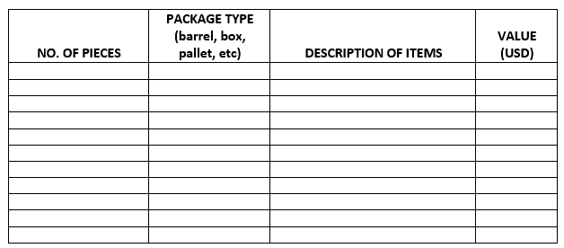
CARICOM (Caribbean Common Market) Invoice (Specimen)

Slide 6
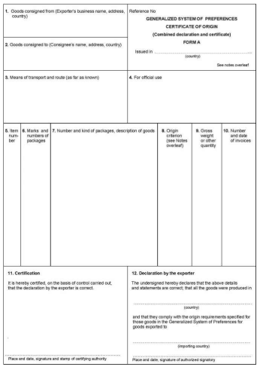
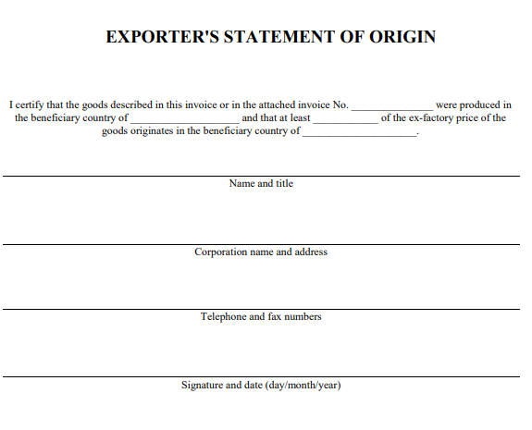

Slide 7
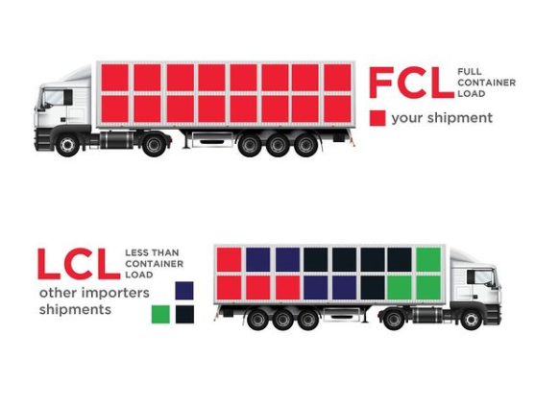
MODES OF TRANSPORT
When shipping your cargo through ocean freight, you will be first asked about the size or volume of your cargo. The cargo size or volume determines the best suitable option for you – LCL shipping or FCL shipping. LCL refers to Less-than-Container-Load, and FCL stands for Full Container Load.
An FCL shipment, or full container shipment, as its name suggests, is a shipment that occupies the entire space of a container without having to share it with other cargo from other shippers.
LCL, or groupage, as it is otherwise known, refers to shipments that take up only a portion of the entire container, and is shipped alongside other merchandise from other shippers in the same container.

Slide 8
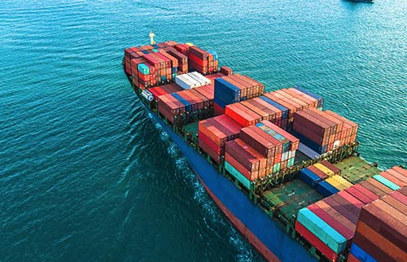
OCEAN FREIGHT
FCL Options: We have rates on file for a 20’ or 40’ container.
We can offer two port options: Rio Haina/Caucedo.
Transit time: 8-10 days
LCL Options:
LCL shipments to DR are routed via Miami, to quote, we require the weight, dims and commodity.
Frequency: weekly
Transit Time: 14 days
Loading Fee is based on Palletized cargo
A commercial invoice is required to quote for Insurance and/or Brokerage
Clearance:
The consignee will require an invoice and packing list to clear their cargo.

Slide 9
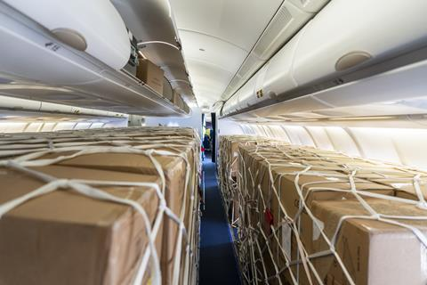
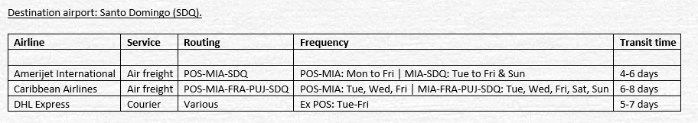
AIR FREIGHT
We currently utilize 3 Airlines for Air Shipments to DR:
Destination airport: Santo Domingo (SDQ).
(With the current challenges with Covid-19, flights are not guaranteed, and schedules are subject to change).

Slide 10
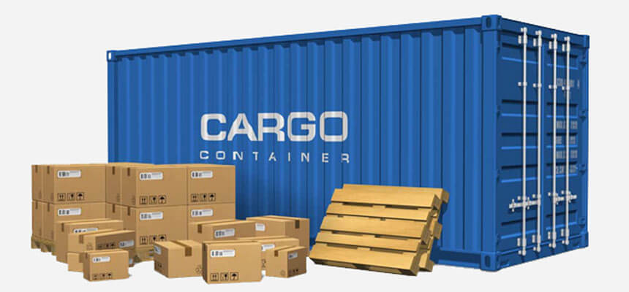
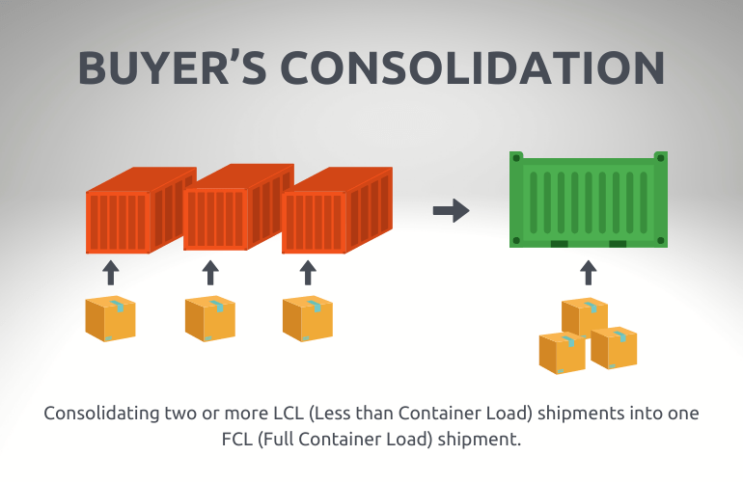
Non-traditional services provided by Forwarders
Consolidation services:
1. Shipper Consolidation:
One local manufacturer consolidating a full container with multiple orders for multiple buyers in the same destination country.
2. Buyer Consolidation:
One consignee at destination purchasing from many manufacturers / sellers in Trinidad and loading into one full container.
Non-traditional services provided by Forwarders;
Loading services. Professionally loading containers for smaller manufacturers who may not have facilities.
Documentation services. Issuing of bills of lading, Certificates of origin, export customs documentation, etc.

Slide 11

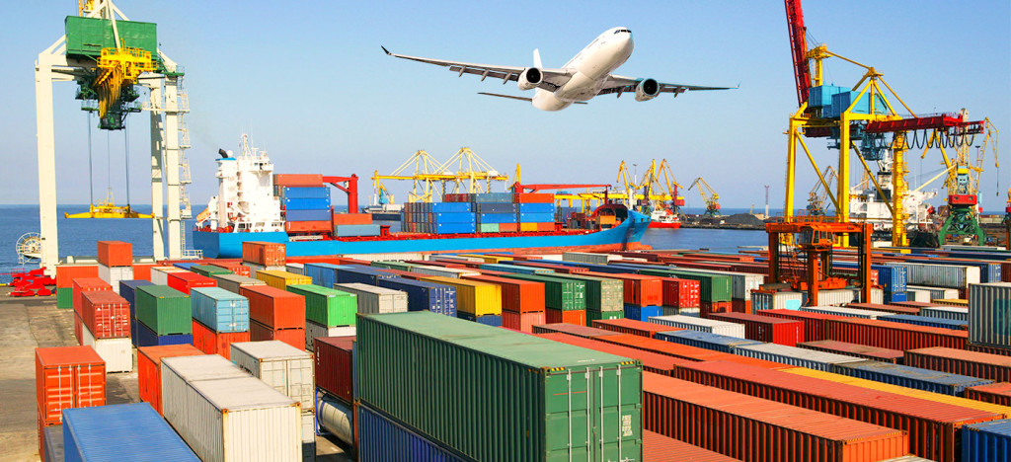

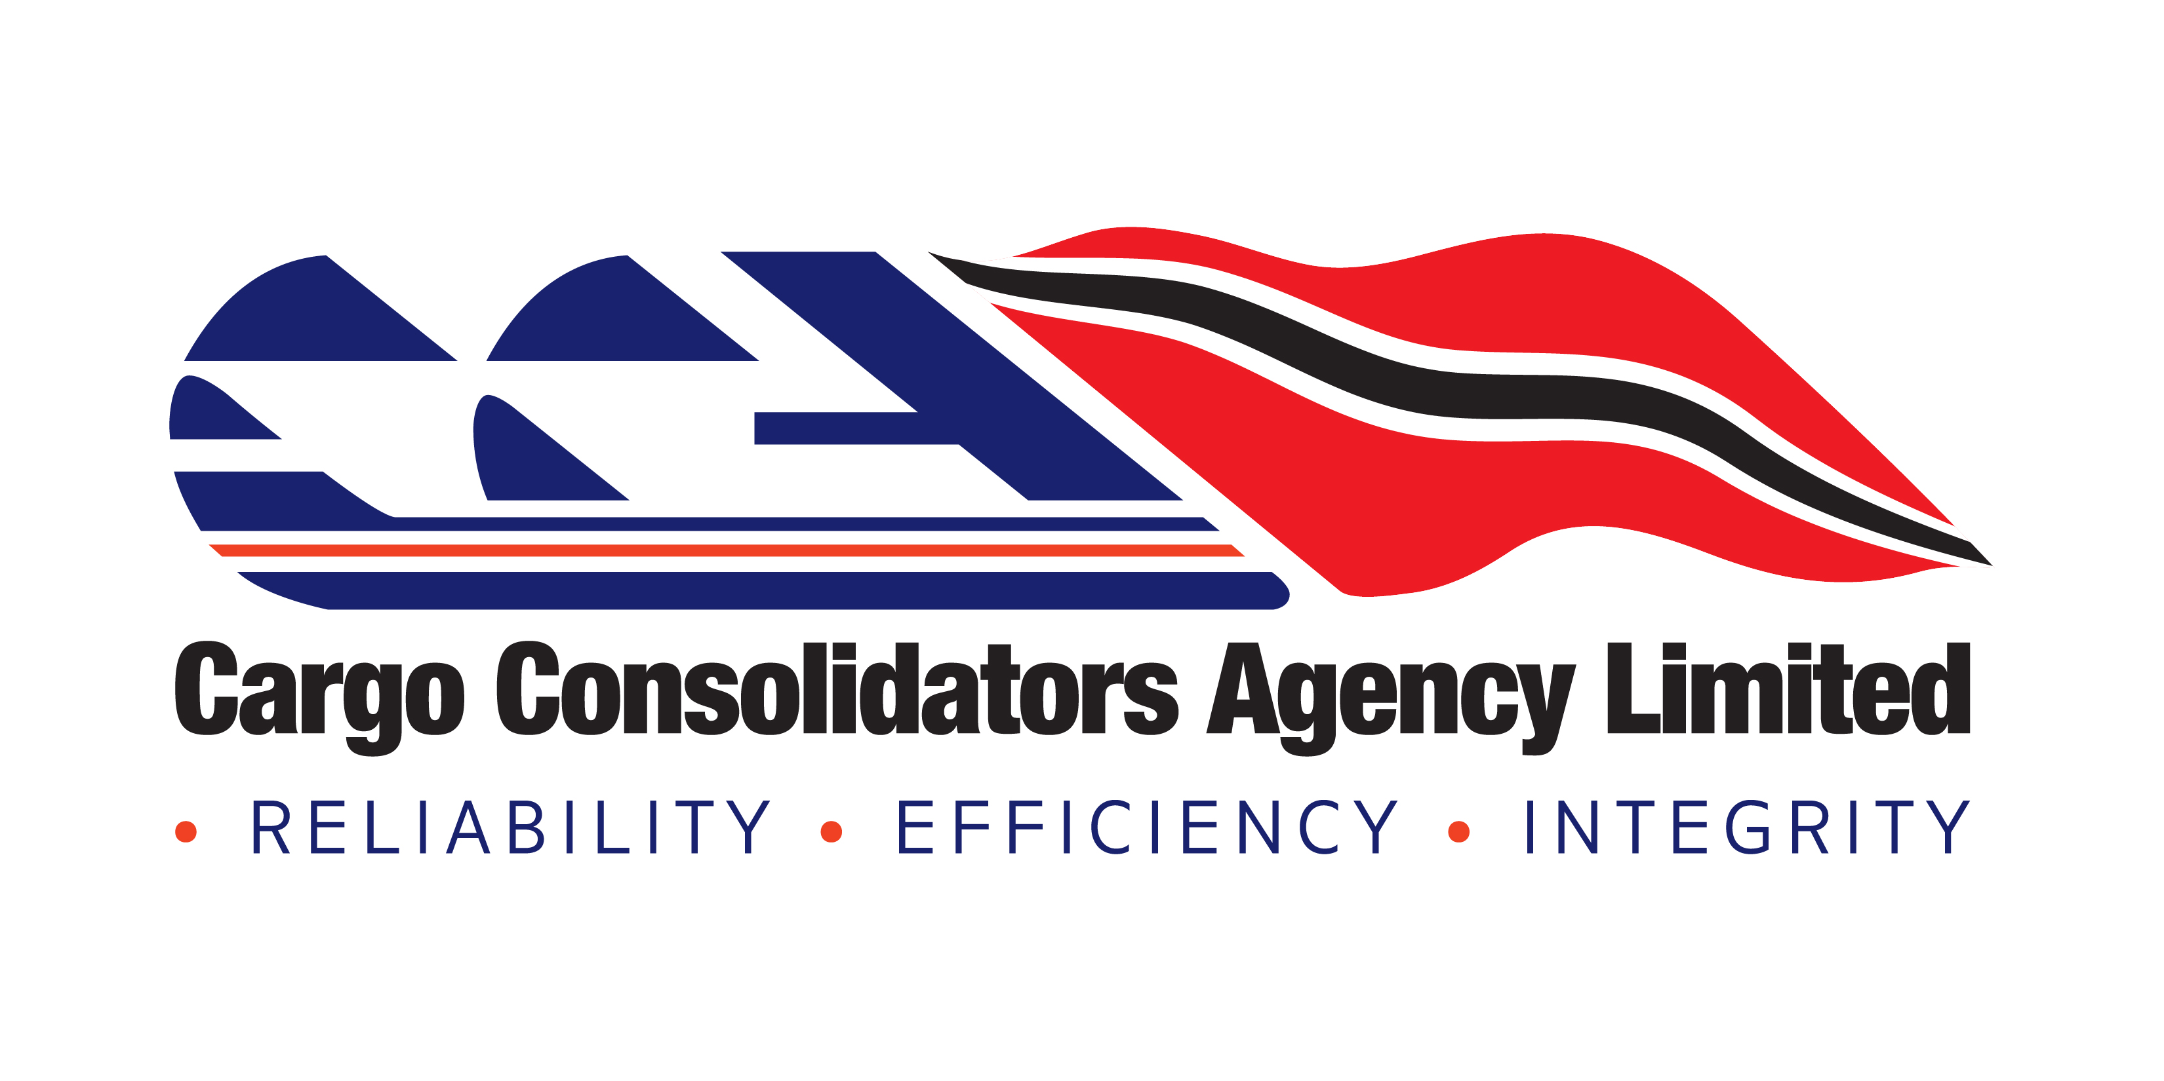
Website: www.cargotrinidad.com
For Quotations or Queries please email: sales@cargotrinidad.com
Tel: 868 223 7447

