Slide 1


Slide 2

HOW TO INVEST IN DOMINICAN REPUBLIC

Slide 3

TABLE OF CONTENTS
Modernization of the Legal Framework
Doing Business in DR.
  II.A. Distributors, agents or dealers
Protection of Industrial Property Rights
Importing products into the D.R.
Health registries
Services in D.R.
Bibliography

Slide 4

I. MODERNIZATION OF THE LEGAL FRAMEWORK

Slide 5

II. DOING BUSINESS
IN D.R.
Dominican Law allows foreign investors to choose within different forms of business organization, making their investments.
Distributors, agents or dealers.
Constitution of companies; creating subsidiaries.
Branch establishment.
Mergers and Acquisitions.
We are going to focus on: Distributors, agents or dealers, considering Law 173.

Slide 6

II.A. Distributors, agents or dealers
THE PROVISIONS OF THE LAW 173 ARE PUBLIC, WHICH INVOLVES TWO BASIC IMPLICATIONS:
The Dominican courts will always interpret the terms of these agreements in accordance with the Law; and,
The clauses that are not consistent with the Law will be void by the Dominican courts.
EXCEPTIONS:
With the application of CAFTA-DR, significant commitments were assumed against this Law. According to the annex ratified by the Dominican Republic, contracts for dealership, distribution, or fabrication signed after the agreement between parties can’t be registered in the Dominican Republic under the Law 173, unless the contract specifies the interest of both parties to register it under this Law .
Foreign companies wishing to appoint agents or dealers in the Dominican Republic should take into account the Law 173 dated April 6, 1966, on the Protection of agents and importers of goods and products, and the Law 16-95 of foreign investment.
Law 173 has been designed to protect the local agents against the unjust termination of their contracts by its foreign licensors. This Law consists of broad scopes and applies to any type of agency agreement, representation, distribution, licenses, concession, franchise or foreign products and services.

Slide 7

III. PROTECTION OF INDUSTRIAL PROPERTY RIGHTS

Slide 8
PROTECTION OF INDUSTRIAL PROPERTY RIGHTS
THE SCOPE OF THE INDUSTRIAL PROPERTY LAW
Patents: protect inventions, utility models and industrial designs.
Brands: Protects all types of brands, including collective marks and classification. The Registry provides the exclusive right for trademark.
Trade Names: protects distinctive signs such as the trade names, labels, emblems, slogans, origin appellations, etc.
Also protected as industrial property in our country, the international treaties and conventions ratified by the Dominican Republic, among which we can mention the following:
Paris Convention for the Protection of Industrial Property.
Agreement on aspects of the Trade Related Intellectual Property Rights (TRIPS).
CAFTA-DR (Chapter 15).
The legal basis for the Protection of Industrial Property Rights in the Dominican Republic is referred to in the Law No. 20-00 on Industrial Property.
Main objective: To provide an appropriate legal framework, contributing to the transfer and distribution of technical knowledge by effectively achieving balance between rights and obligations concerning those who hold the property rights. This Law also promotes social development and the interests of technological advancement of the country.
Oficina Nacional de Propiedad Industrial
(National Office of Industrial Property)
Created under the Law 20-00, constitutes the governmental agency responsible for granting patents and register the industrial property rights.

Slide 9
IV. IMPORTING PRODUCTS
INTO THE D.R.
It is important to make imports from the Dominican Republic, maintain a legally constituted company with a valid National Taxpayer Registry of the DGII and make liaison with the DGA and Customs Technical Agency.
REMEMBER, IMPORTANT
The importation of:
Medicines with controlled substances through the Ministry of Public Health (https://www.msp.gob.do/web/?page_id=5756);
Products and by-products of plant origin through the department of agriculture (http://agricultura.gob.do/servicios/informacion-sobre-procedimientos-para-la-importacion-de-productos-y-sub-productos-de-origen-vegetal/); and,
The Import of livestock products through la Ventanilla Única de Comercio Exterior de la República Dominicana (https://vucerd.gob.do/media/1808/importacion-de-alimento-animal-de-consumo-animal.pdf)

Slide 10






V. HEALTH REGISTRIES
The sanitary registration certification is a service request to obtain a certification describing the current information on the substance or health products that have been registered by the Ministry of Public Health of the Dominican Republic. It can be done to:
Medicines
Cosmetics, Personal and Home Hygiene Products.
Medical devices.
Food and drinks:
  Condensed, evaporated and dulce de leche milk
  Fats, oils and fat emulsions
  Fruits and vegetables (packed)
  Confectionery products
  Cereals and derivatives
  Bread and bakery and pastry products
  Sweeteners and sweeteners, including honey
  Sauces, dressings, spices and condiments
  Non-alcoholic beverages (except for bottled waters and energy drinks)
  Dry snacks
  Broths, soups, creams and dehydrated mixes
Decree No. 528-01; General Regulation of Risk Control in Food and Beverages.
Decree No. 82-15; That Creates the DIGEMAPS.
Resolution No. 000012 of 07/25/2017 that establishes the criteria for the application of the Sanitary Registry by Simplified Procedure.
Resolution No. 000011 of 07/25/2017 that establishes the application criteria to opt for the Sanitary Notification and Automatic Renewal Procedure.

Slide 11
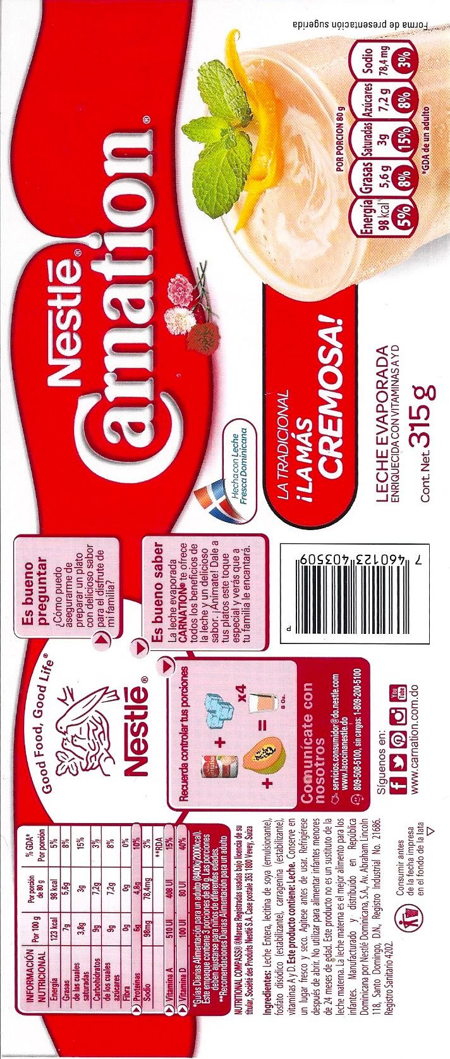
Highlight, example:
Packaging and Labeling: NORDOM-53 y RTD-53
It is mandatory to place a label on the packaging of all prepackaged food and beverages, in which the following information must appear, except when expressly indicated otherwise in the Dominican Technical Standard (NORDOM 53 and RTD 53, among others):
The containers, utensils, devices, containers, covers and wrappings destined for the manufacture, preservation and fractionation of food may only be made of the following materials, and those specially indicated for certain products must be used while not altering or contaminating such foods:
Steel, cast iron or beaten iron, copper and brass
Tinplate of first use
Nickel
Iron, fired and varnished clay
Crockery or porcelain
Cardboard or paper
Rubber
Plant or animal fabrics
Various metals, technically pure, in thin sheets for wrapping sausages or cheeses.
Artificial resins, cellulose, cassena and polyethylene derivatives.
Health Registry number
Industrial Registry number
Name of the product
Name and address of the manufacturer and the importer or seller of the product
List of ingredients
Cuntry of origin
Net weight
Instructions on the use and conservation of the product

Slide 12
VI. SERVICES
IN THE D.R. :
Free Zone Regime
The incentives are established in article 24 of Law 8-90. Free zone operators and companies established within them are protected under the customs and tax regime and consequently receive 100% exemption on the following payments:
On the payment of income tax established by Law No. 5911, of May 22, 1962, and its amendments, referring to Stock Companies.
The payment of taxes on construction, loan contracts and on the registration and transfer of real estate as of the constitution of the corresponding free zone operator.
Of the payment of taxes on the constitution of commercial companies or of increase of the capital of the same ones.
Of the payment of municipal taxes created that may affect these activities.
Of all import taxes, tariffs, customs duties and other related charges, which affect raw materials, equipment, construction materials, parts of buildings, office equipment, etc., all of them destined to: Build, enable or operate in free zones.
Of all existing export or re-export taxes, except those established in Sections f) and g) of Article 17 of the Law.
Tax on patents, assets or heritage, as well as the transfer tax on industrialized goods and services (ITBIS).
Consular fees for all imports destined for free zone operators or companies.
From the payment of import taxes, relative to equipment and utensils necessary for the installation and operation of cheap dining rooms, health services, medical assistance, childcare, entertainment or amenities and any other equipment that tends to the well-being of the working class.
Payment of import taxes on transport equipment that are cargo vehicles, garbage collectors, minibuses, minibuses for the transport of employees and workers to and from the work centers with prior approval, in each case by the National Council of Free Zones from exportation. These vehicles will not be transferable for at least five (5) years.
The free zone regime is regulated by Law 8-90 on the Promotion of Free Zones and under the control of the National Council of Export Free Zones (CNZFE).
Said law promotes the installation of companies that manufacture products or offer services to the foreign market, facilitating said processes with the granting of various incentives.

Slide 13
VI. SERVICES
IN THE D.R. :
Consulting Services
EXCEMPT SERVICES
Article 344.- Exempt Services. (Amended by Article 25 of Law No. 253-12 dated November 9, 2012.) The provision of the services detailed below is exempt from the payment of the Tax on Transfers of Industrialized Goods and Services.
Financial services, including insurance.
Pension and retirement plan services.
Land transportation services for people and cargo.
Electricity, water and garbage collection services.
Housing rental services.
Health services.
Educational and cultural services.
Funeral services.
Services of Beauty Salons and Hairdressers.
Tax part that is established locally for consulting services from abroad, according to article 305 of the tax code;
Artículo 305.- (Modificado por la Ley 253-2012, de fecha 09 de noviembre del 2012). Pagos al Exterior en General. Salvo que se disponga un tratamiento distinto para una determinada categoría de renta, quienes paguen o acrediten en cuenta rentas gravadas de fuente dominicana a personas físicas, jurídicas o entidades no residentes o no domiciliadas en el país, deberán retener e ingresar a la Administración, con carácter de pago único y definitivo del impuesto, la misma tasa establecida en el artículo 297 del presente Código Tributario. Las rentas brutas pagadas o acreditadas en cuenta se entienden, sin admitir prueba en contrario, como renta neta sujeta a retención excepto cuando esta misma ley establece presunciones referidas a la renta neta obtenida, en cuyo caso la base imponible para el cálculo de la retención será la renta presunta.

Slide 14
Thanks for your attention!

Slide 15
BIBLIOGRAPHY
CORRAL, L. (2020). Las Zonas Francas en República Dominicana: oportunidad de inversión para recuperar la producción y beneficios. 2021, de LinkedIN Sitio web: https://es.linkedin.com/pulse/las-zonas-francas-en-rep%C3%BAblica-dominicana-oportunidad-leandro-corral
MINISTERIO DE AGRICULTURA DE LA REPÚBLICA DOMINICANA (2021). Departamento importación exportación productos, Sitio web: http://agricultura.gob.do/servicios/informacion-sobre-procedimientos-para-la-importacion-de-productos-y-sub-productos-de-origen-vegetal/
MINISTERIO DE INDUSTRIA Y COMERCIO REPÚBLICA DOMINICANA. (2021). Guía para exportar. 2021, de MIC Sitio web: https://micm.gob.do/images/pdf/doc/Guia-para-Exportar.pdf
MINISTERIO DE SALUD PÚBLICA DE LA REPÚBLICA DOMINICANA. (2021). Certificación Registro Sanitario. 2021, de Salud Pública Sitio web: https://www.msp.gob.do/web/?page_id=6256
NOVA, A. (2019). ERC aporta 1,650 empleos a República Dominicana con sus call centers. 2021, de El Dinero Sitio web: https://eldinero.com.do/85225/erc-aporta-1650-empleos-a-republica-dominicana-con-sus-call-centers/
REPÚBLICA DOMINICANA. Exportación de alimento animal y comsumo animal, Ventanilla única de Servicios. Sitio web: https://vucerd.gob.do/media/1808/importacion-de-alimento-animal-de-consumo-animal.pdf
REPÚBLICA DOMINICANA, leyes.

Slide 16
Telf. +1 (809) 549-4646
Licda. Gina A. Hernández Vólquez
ghernandez@alburquerque.com.do

